Slide 1
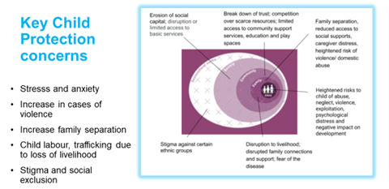
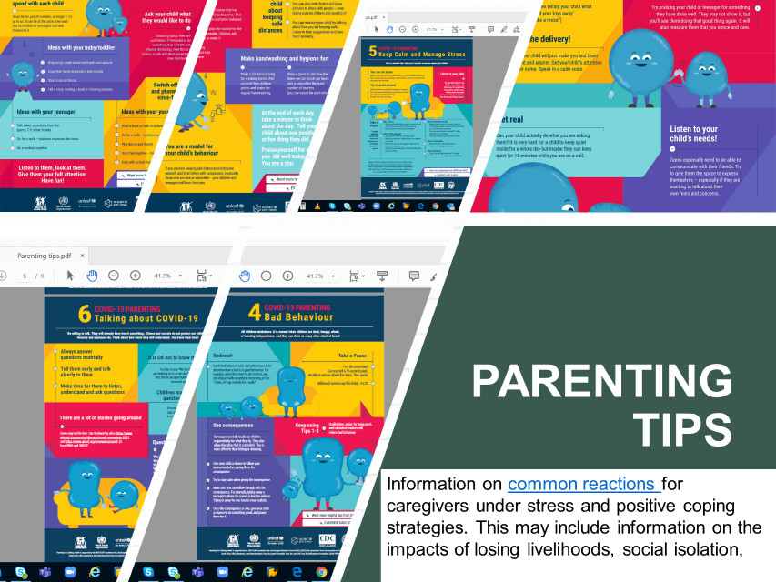
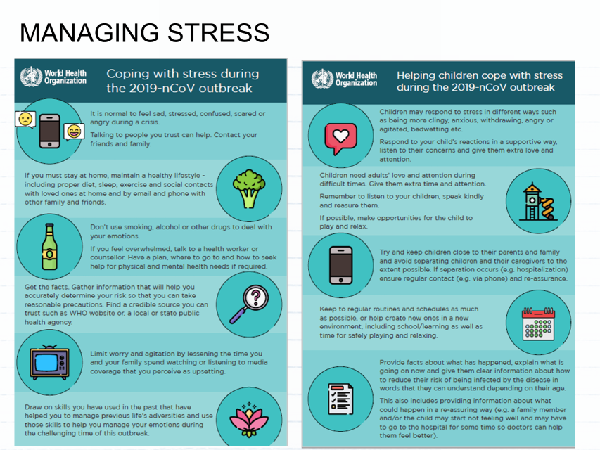
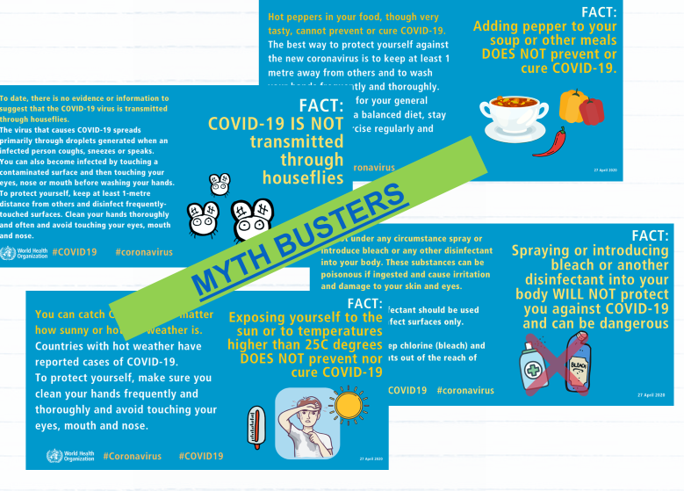
PSYCHOLOGICAL TIPS
ADOLESCENT TOOLKIT
PSS MANUAL
E BOOK & AUDIOBOOK
COMIC BOOKS
S&D BOOKLET
S&D FILMs

Slide 2
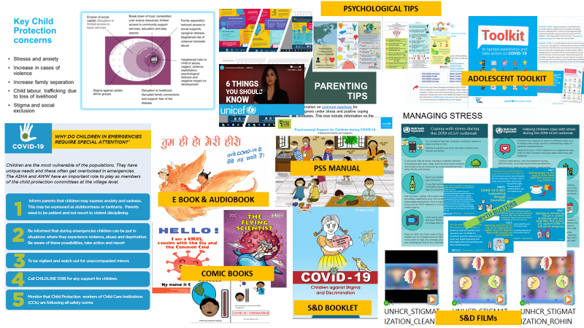
C4D- Child Protection COVID Sensitive Programming
-Recognise violence against women and children
-Need for Mental health and Psycho-Social Support and stigma prevention package
-Reach & Engage Adolescent and youths with messages on hand washing, social distancing, myths- misconception, stigma and psychosocial counselling
-Parental guidance and advisory on staying safe online and following internet hygiene during COVID-19
-Refer to CHILDLINE 1098/1091 helpline services including counselling

