Slide 1

+
Helping kids grow smarter, stronger and kinder

Slide 2
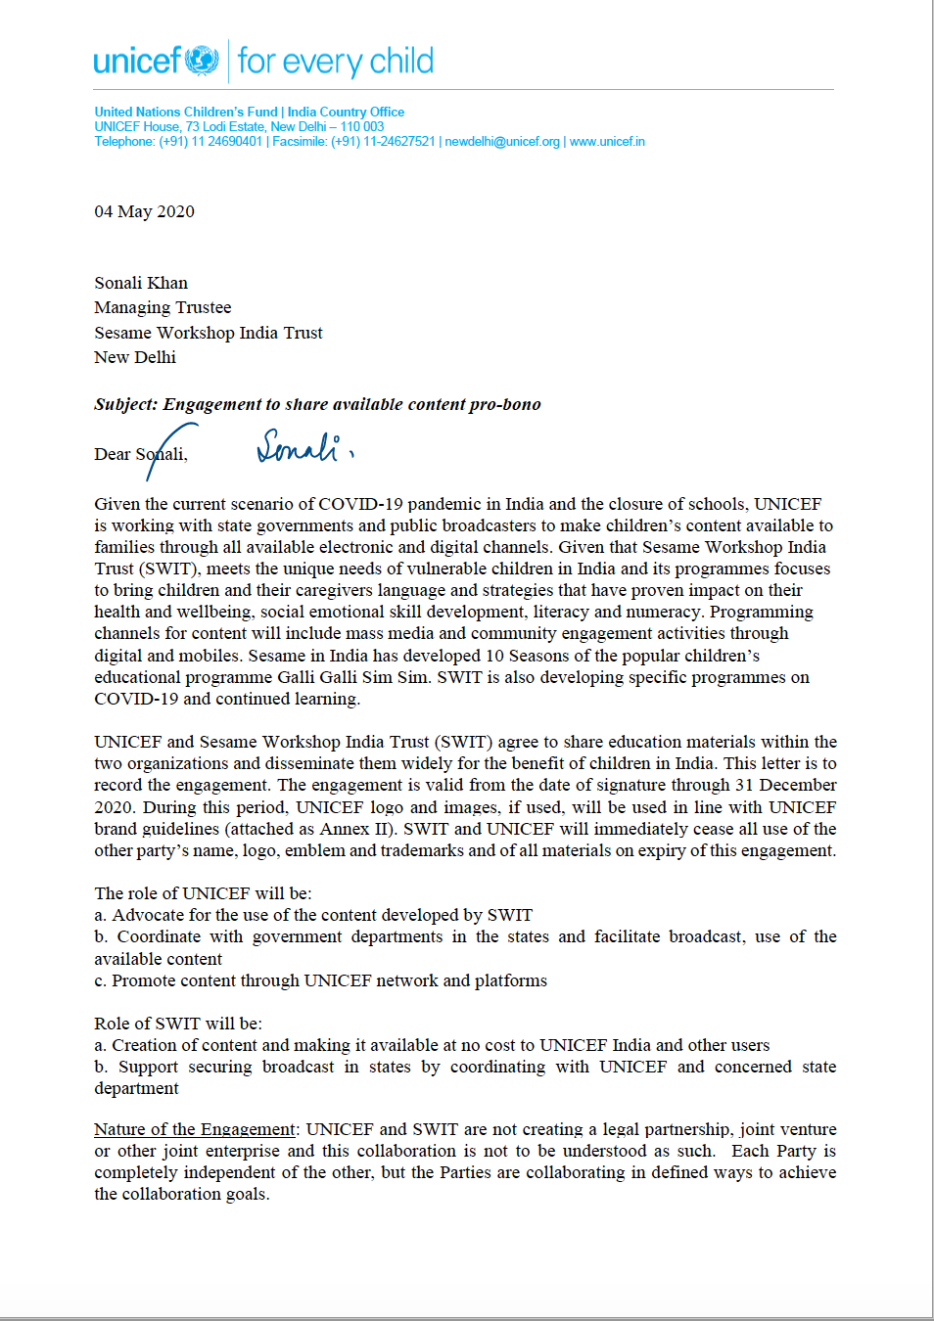
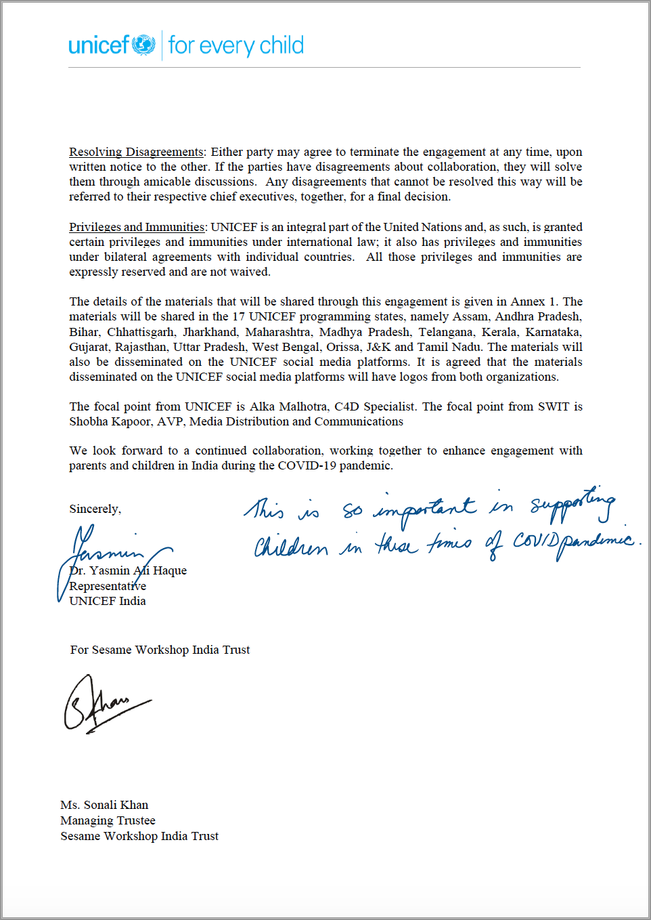

The partnership

Slide 3


Partner Strengths
Advocacy, Multisectoral, Presence in states
Engaging and tested ECCE content
Reaching children & parents/ caregivers to facilitate independent learning at home and strengthening of parent-child bond

Slide 4


Addressing what matters the most
Thematic Framework
Knowledge & Prevention
Social-Emotional Care & Well-being
Child Protection
Recognize
React
Reduce
Continued Education
Health & Wellbeing, Cognition, Science & Nature, Art & Creativity, Math, Language & Literacy
Information on COVID-19​
Handwashing​
Sneezing & coughing etiquette​
Social Distancing​
Reassurance
Regulation
Routine
Resilience

Slide 5
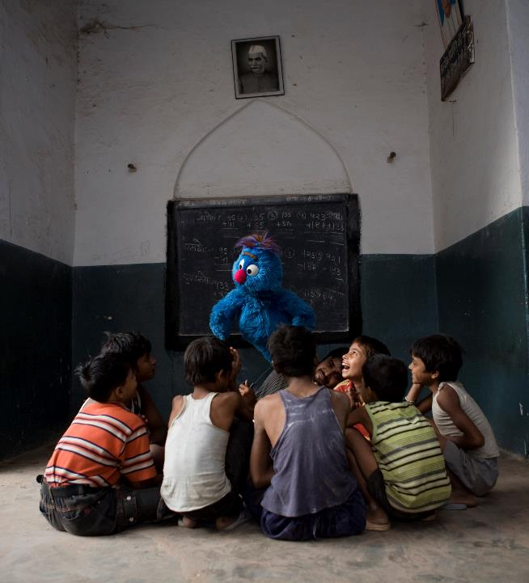
Joint effort, some results
PAN India: DD National
Uttar Pradesh: DD Uttar Pradesh, Dikhsha app, 800+ WhatsApp groups
Madhya Pradesh: DD Madhya Pradesh, Local cable network
Maharashtra: DD Sahyadri, Diksha App,
Bihar: DD Bihar
Jharkhand: DD Jharkhand
Jammu & Kashmir: AIR Srinagar

Slide 6
CONTENT: Varied formats, all audiences
Videos
Audio
E-books
Articles for parents
E-activity sheets/ printables

Slide 7
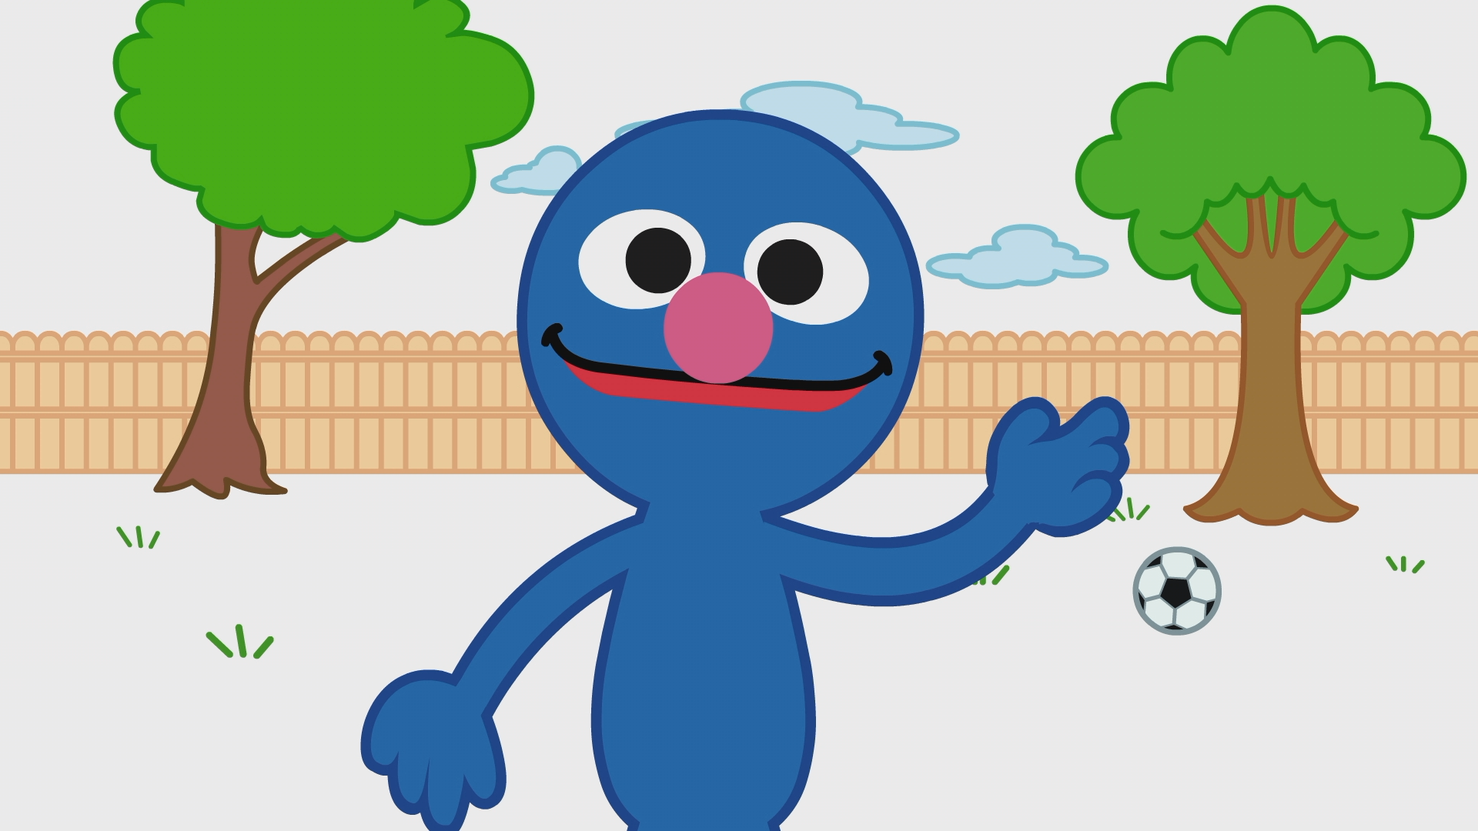
Content examples
For children:
Grover is guided about sneezing etiquette.
Feel that you’re about to sneeze-move aside from other people
bring your elbow towards your face
cough/sneeze in bended elbow

Slide 8
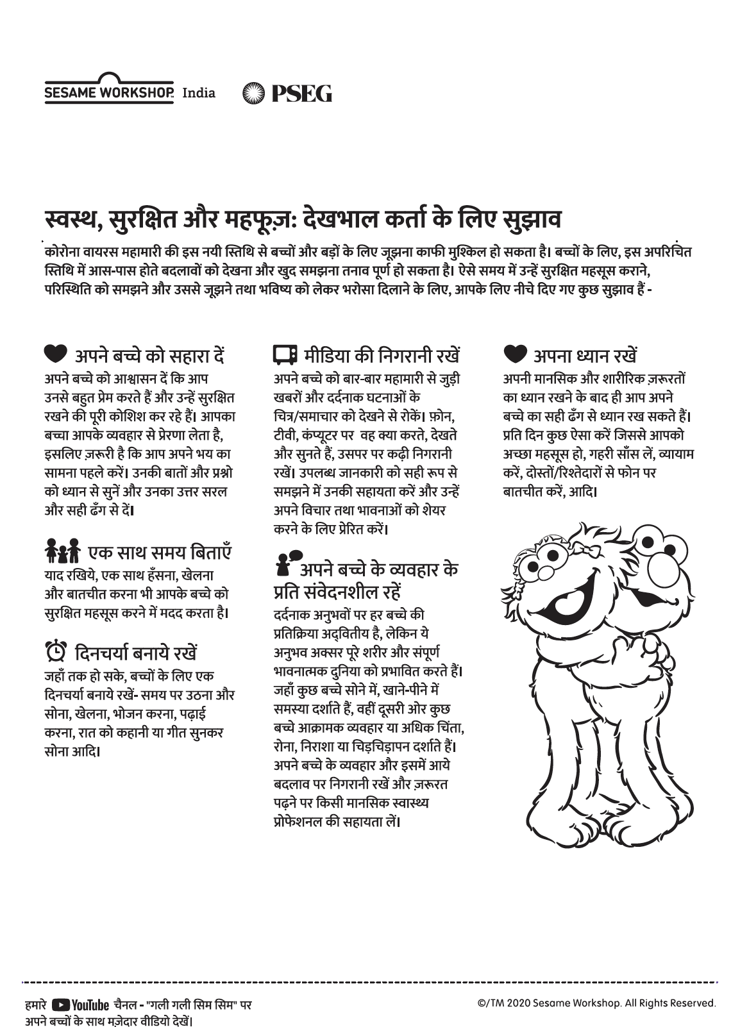

Content examples:
Article for parents: support children during COVID-19 crisis
Printables for children- we (children) are being taken care of
Audio PSA: What is social distancing? How can we have routines?

Slide 9
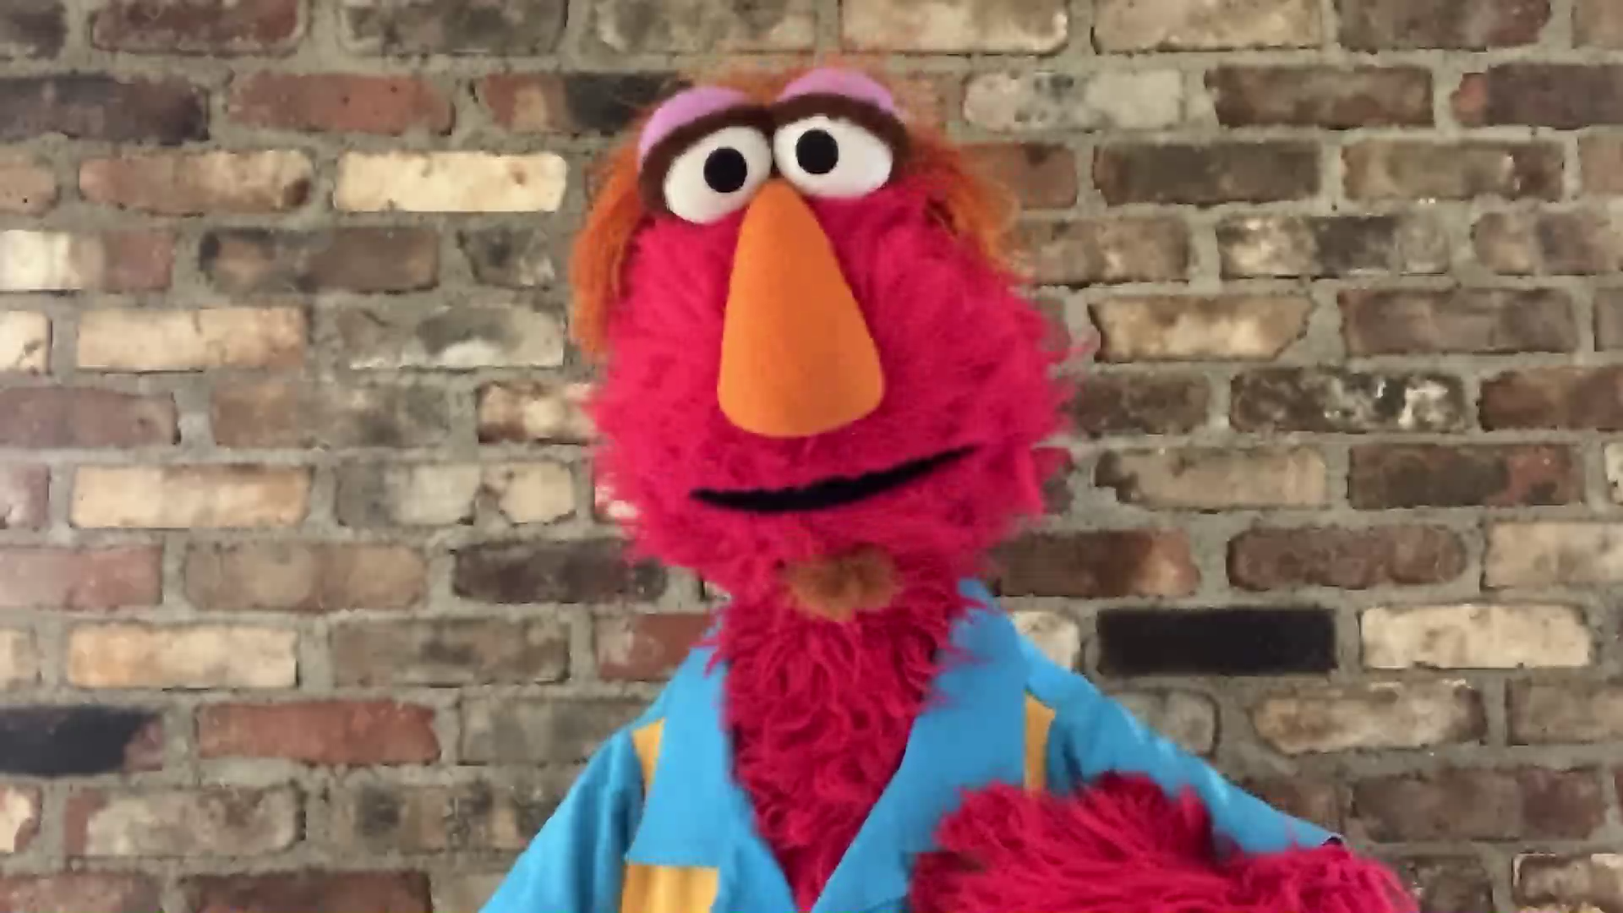
Content examples:
For parents/caregivers
Louie’s message to parents:
It is okay to feel stressed and worked up.
Take out time for yourself as you juggle other roles and responsibilities and remember
Taking care of yourself is the first step towards taking care of others

Slide 10




Content examples:
E-books:
Themes covered include Math, Health & Hygiene, Language & Literacy, Environment & Nature etc.

Slide 11
Content examples:
Activity sheets:
Child can simply attempt the activity sheets on screen, trace, move finger around, identify etc.

Slide 12

For further details, please email us at amalhotra@unicef.org and shobha.kapoor@sesame.org
Thank you

